Slide 1
超越学科界限的认知基础 Transdisciplinary Cognitive Foundation
Safety
Nothing
bad happens
Liveness
Some
Good Things
Must Happen
Image Source: Get your guide
信息控制论(Cybernetics): 控制与通信 Week 08
Ben Koo
November 3, 2021

Slide 2

Logic Model
Logic Model
Output: A statements about Cybernetics was formulated as a Transdisciplinary Cognitive Foundation
Process: Review, Lecture and Discussion
Input:
Universal Computation is true
Reference material about Cyb.
Historical accounts of agencies.
Examples of tech applications
Context: Students have been introduced to NsM and Recursion, and all Programs are Lattices/Posets
Goal: Show Cybernetics as an early attempt toward Transdisciplinary Cognitive Foundation
Criteria: introduction to
Personalities and publications
Institutions, regulatory examples
Technologies derived from Cyb.
A well-defined set of Actions and iterative Branching Strategies
A Roadmap of composable activities
Sequencing and timing conditions
Explicitly state dependencies and resource requirements
Boundary Conditions: audience should also accept the ubiquity of networked computing applications

Slide 3


Glossary
Cybernetics: A scientific foundation that cut across disciplines
Kubernetes: The Greek Spelling of Cybernetics, meaning pilot
Governor: The Latin corruption of Kubernetes, according to Wiener
Software Products
Kubernetes: is also the name of an Open Sourced platform for managing containerized workloads and services, that facilitates both declarative configuration and automation. (see website) Originally created by Google.
Container Technology: A container is a standard unit of software that packages up code and all its dependencies so the application runs quickly and reliably from one computing environment to another.
Docker container image: a standalone, executable package of software.

Slide 4
Prior to today’s lecture
All Knowledge represented by Named Functions
This set of rules can be used recursively to generate an infinite amount of expressions.
Variable
Expression1
Expression2
𝜆
Variable
Expression
( )
Expression

Slide 5
A Rhetoric Lens to see the world
Focus on the relational structures between Names
This set of rules can be used recursively to generate an infinite amount of expressions.
Variable
Expression1
Expression2
𝜆
Variable
Expression
( )
Expression

Slide 6
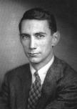
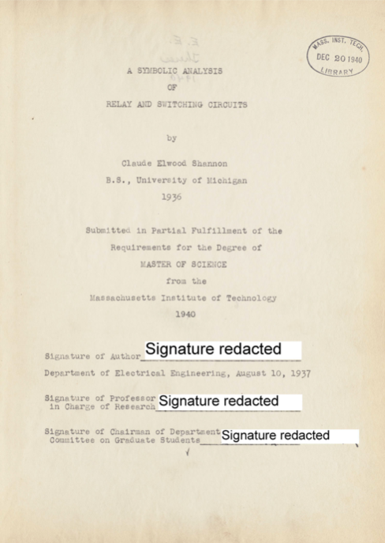
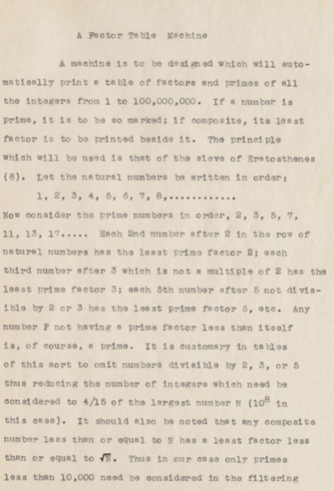
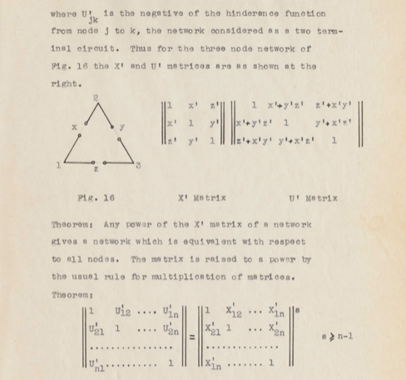
The most famous master thesis
A Symbolic Analysis
of
Relay and Switching Circuits
Claude Shannon, 1916-2001

Slide 7
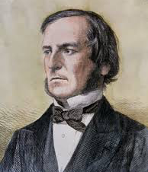
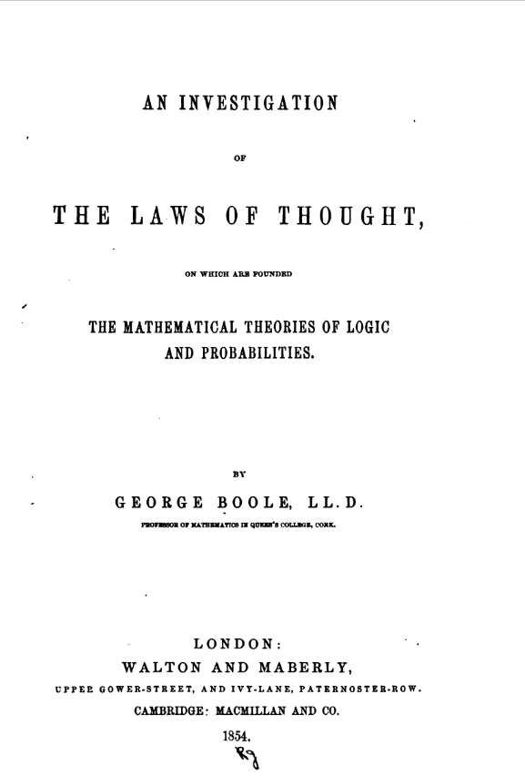
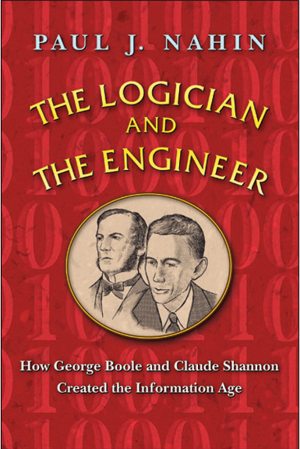
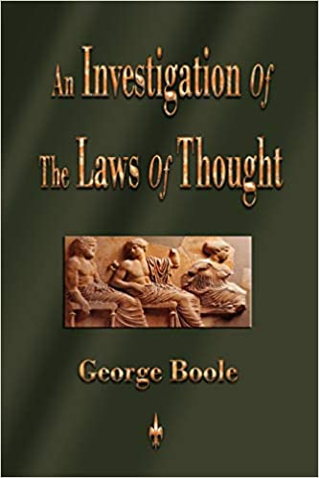
From Law of Thought to Symbolic Analysis of Circuit
George Boole
Boolean Algebra

Slide 8
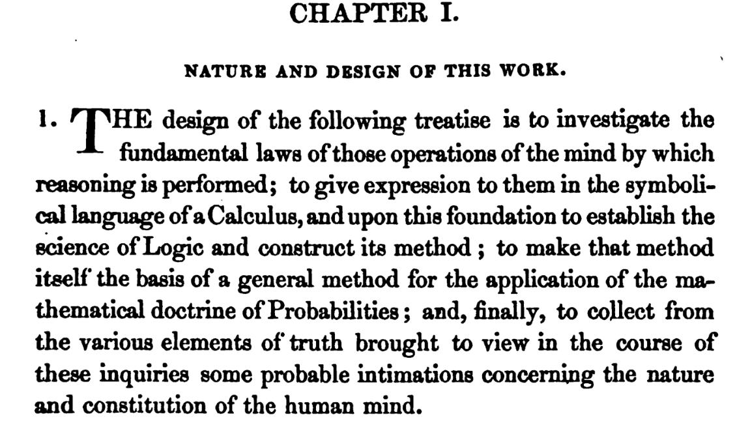
A Treatise on Cognitive Foundation
Image Source: An Investigation of the Laws of Thought by George Boole

Slide 9
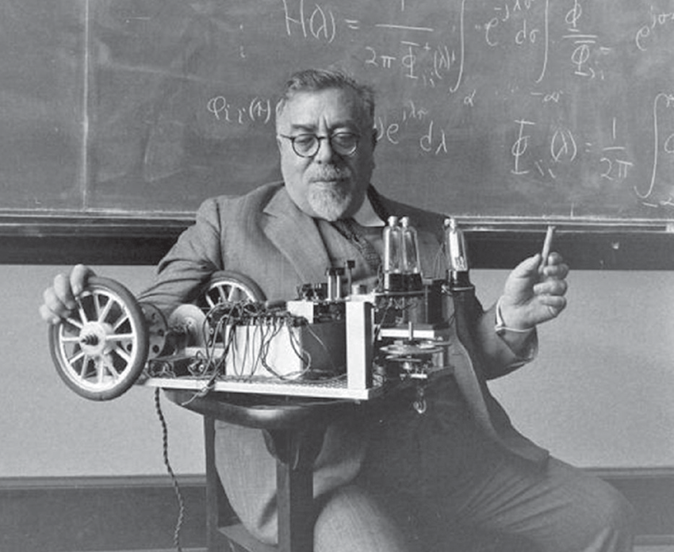
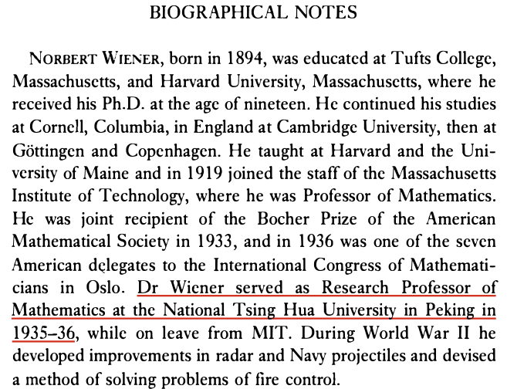
The Dominant Personality behind Cybernetics
Cybernetics:
the science of control and communication in the animal and the machine.
- Norbert Wiener
Excerpt from The Human use of Human Beings
Image source: Research Gate download Link
Innovation occurs at the boundary of disciplines by competent people.
- Norbert Wiener

Slide 10
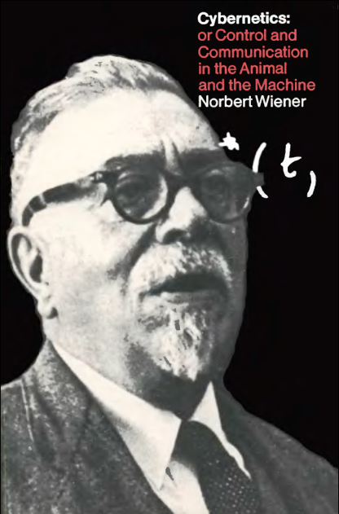
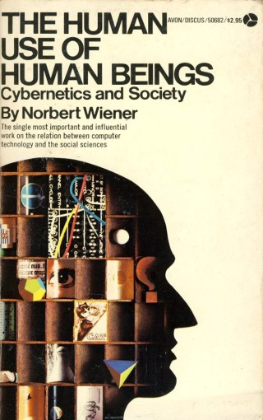
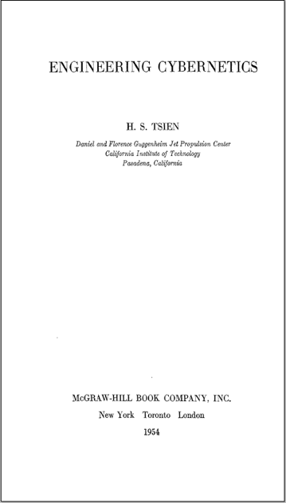
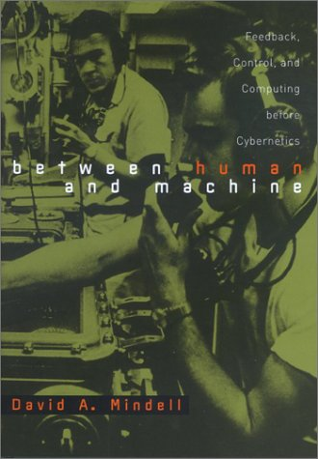
A few books on Cybernetics

Slide 11

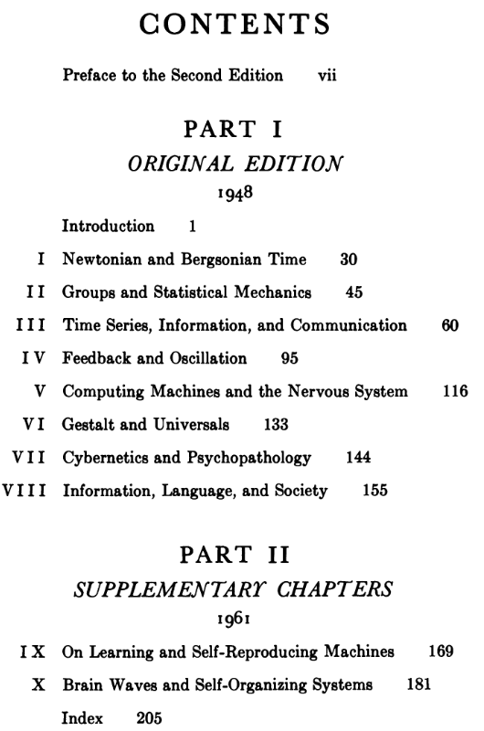
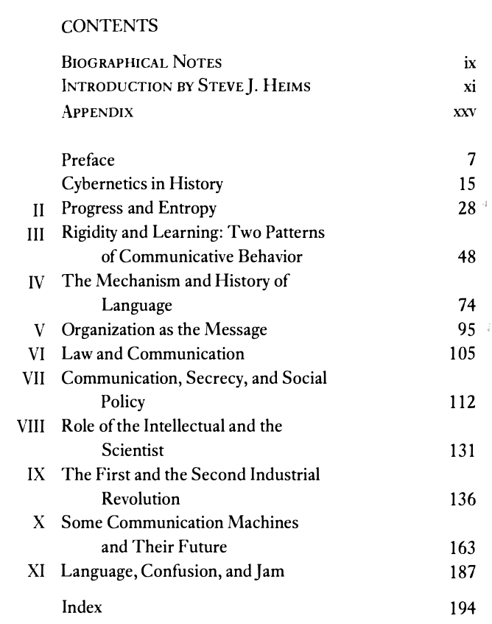
Wiener’s Cybernetics’s Tables of Content

Slide 12
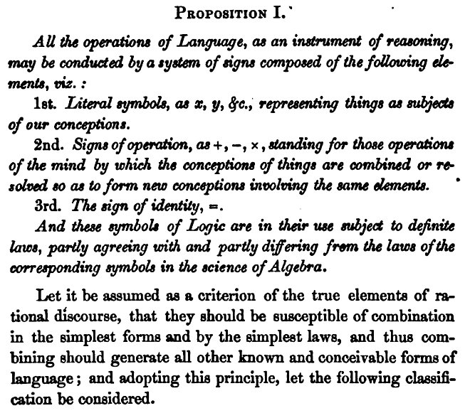
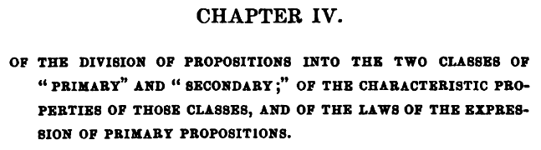
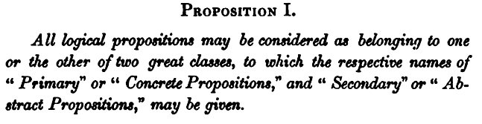
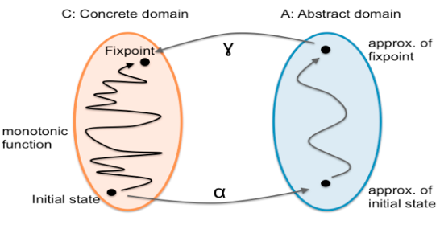
The Analysis and Classification of Signs
Image Source: An Investigation of the Laws of Thought by George Boole

Slide 13
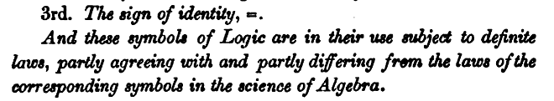
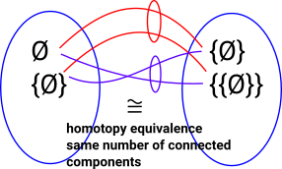
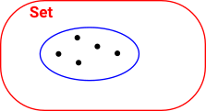
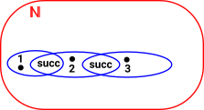
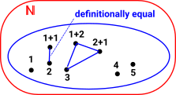

The Notion of Logical/Symbolic Equivalence
Isomorphism
Equivalence
Id_{A} = G◦F
F◦G = Id_{B}
Id_{A} ≃ G◦F
F◦G ≃ Id_{B}
Homotopy Type Theory / Univalence Axiom
Image Source: Euclidean Space on Univalence Axiom

Slide 14

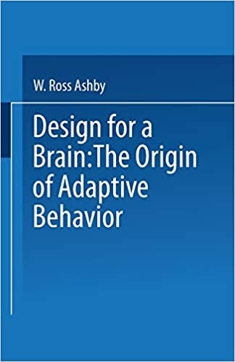
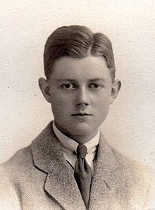
Ashby’s vision on Cybernetics
Ashby, c. 1924, aged about 21
The initial member of Ratio Club
Image Source: Introduction to Cybernetic by Ross Ashby

Slide 15
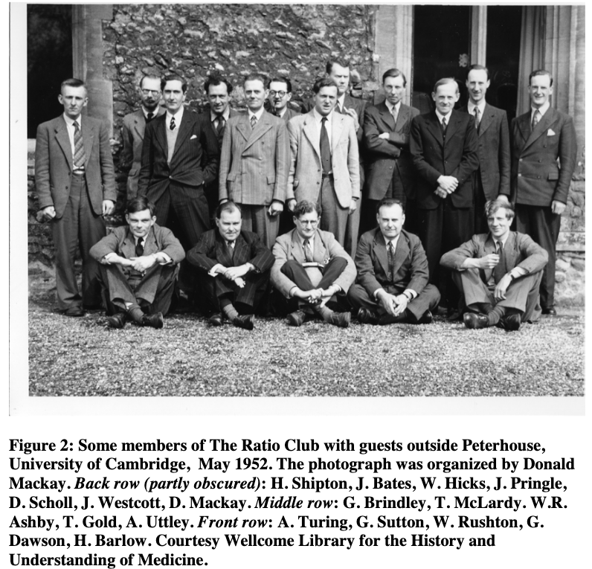
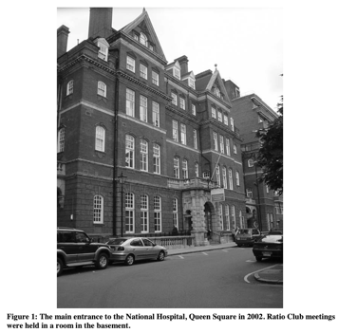
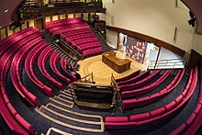
The ”institution” that gave birth to Cybernetics
Members:
Ross Ashby, trained in medicine and psychiatry, authored Intro to Cyb.
Horace Barlow FRS, a great-grandson of Charles Darwin
John Bates, who initiated the idea of the Ratio Club
…
Alan Turing, the guy who invented the digital computer
W.E. Hick, a pioneer of information theoretic thinking in psychology.
Eliot Slater, an eminent British psychiatrists of the twentieth century.
John Westcott FRS, just returned from a year in Wiener’s lab at MIT.
…
FRS: Fellowship of the Royal Society
The Royal Institution Lecture Theatre. Here Michael Faraday first demonstrated electromagnetism
Image Source: The Ratio Club: A Hub of British Cybernetics by Phil Husbands and Owen Holland

Slide 16
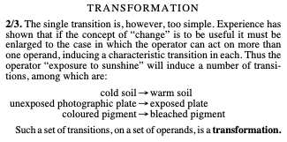
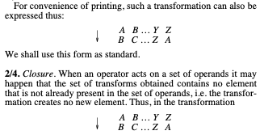
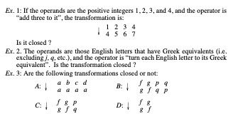
Think of Universal Mechanism as a Rewrite System
Cybernetics is similar in its relation to the actual machine. It takes as its subject-matter the domain of “all possible machines”, and is only secondarily interested if informed that some of them have not yet been made, either by Man or by Nature. What cybernetics offers is the framework on which all individual machines may be ordered, related and understood.
Text and Image Source: Introduction to Cybernetic by Ross Ashby

Slide 17
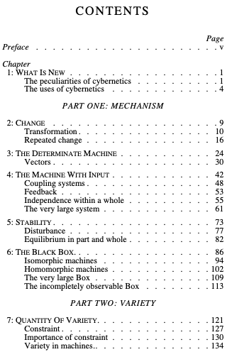
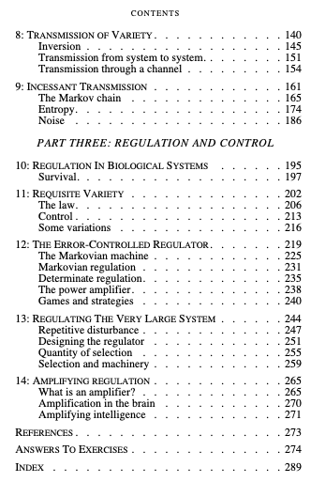
Ashby’s Intro to Cybernetics Table of Content
Mechanism
The Data and Mathematical(Computational) Abstraction
Variety
Quantity, Transmission of Data, Noisy Transmission of Data
Regulation and Controlling
Regulatory strategies, biological examples, System Control at Scale

Slide 18
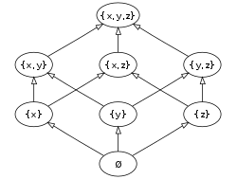
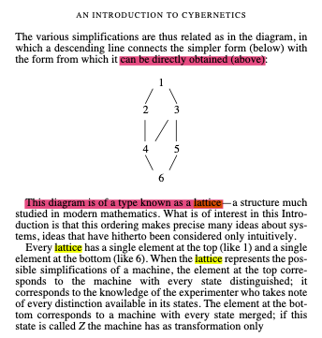
Partially Ordered Set (POS)
Top (Meet)
P. 108 of Intro to Cyb, by Ashby
Bottom
The Hasse diagram of the set of all subsets of a three-element set {x, y, z}, ordered by inclusion. Distinct sets on the same horizontal level are incomparable with each other. Some other pairs, such as {x} and {y,z}, are also incomparable. (Image and Text Source: Wikipedia: POS )

Slide 19

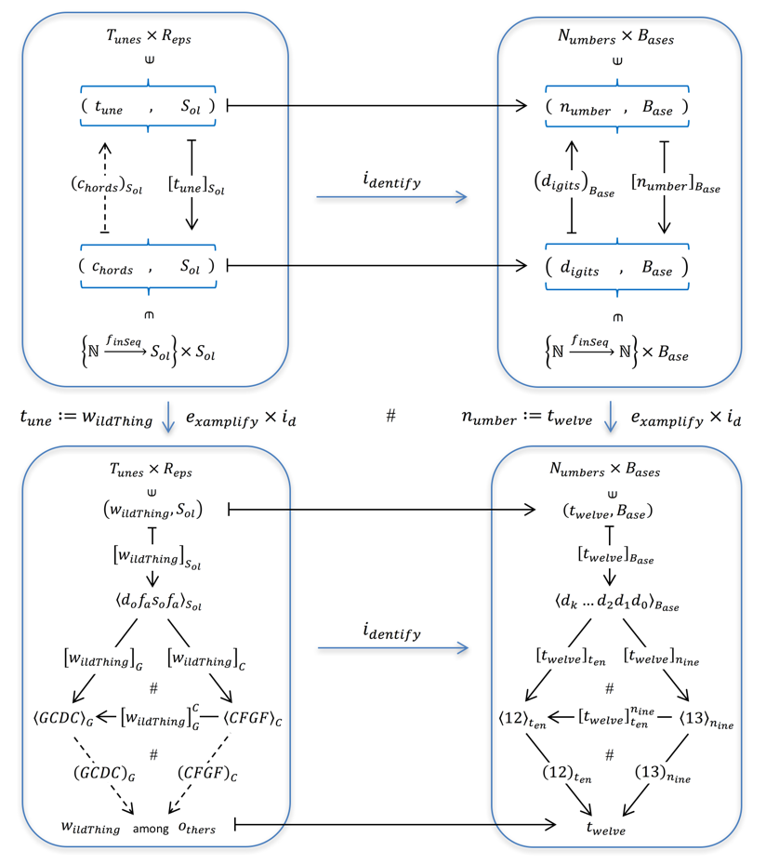

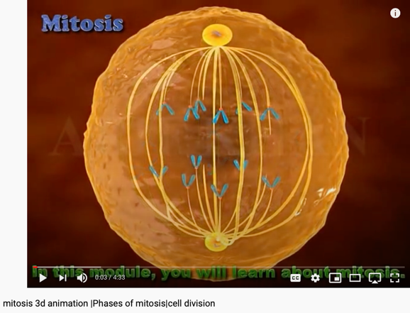
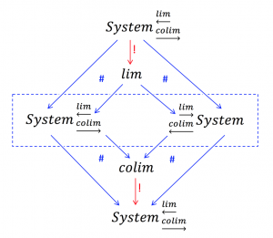
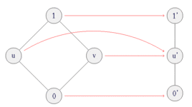
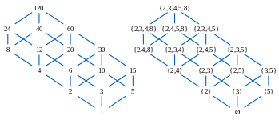
All System can be approximated as Partially Ordered Set
Numbers are naturally related to Music:

Slide 20
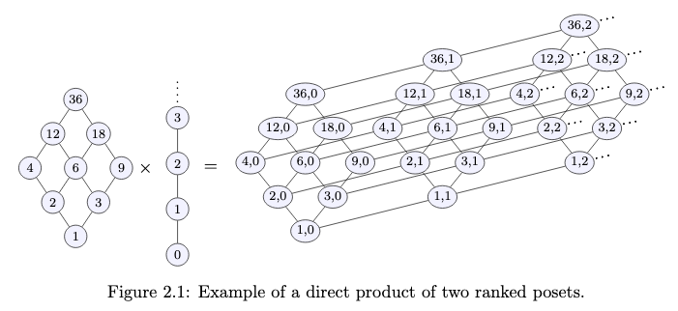
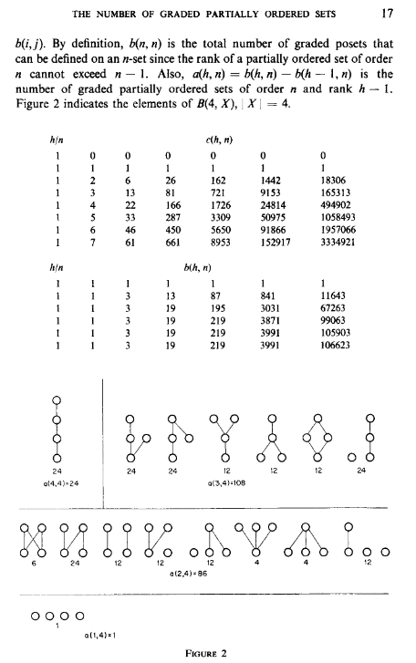
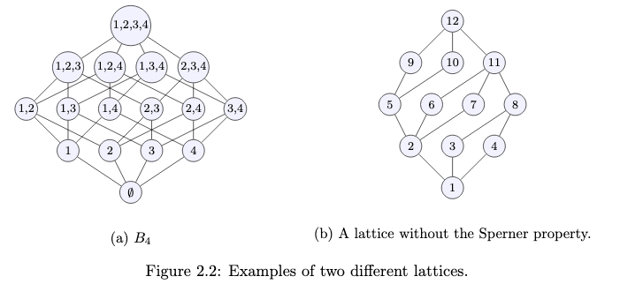
Posets as Composable Namespaces
Image Source: Symmetric chain decompositions of partially ordered sets by Ondrej Zjevik
Image Source: The Number of Ordered Partially Ordered Sets by David Klarner

Slide 21
Category Theory and Unary Arithmetic
What if all computable objects are treated as Lattices?
Verbs and Nouns inherit from the same root type!
Operators and Operands are just named “Expressions”

Slide 22
The Fundamental Theorem of X
Arithmetic: (Named Composition in Number Theory)
In number theory, the fundamental theorem of arithmetic, also called the unique factorization theorem or the unique-prime-factorization theorem, states that every integer greater than 1^{[3]} either is a prime number itself or can be represented as the product of prime numbers and that, moreover, this representation is unique, up to (except for) the order of the factors.^{[4][5][6]}
Algebra: (Closure in Composition)
The fundamental theorem of algebra states that every non-constant single-variable polynomial with complex coefficients has at least one complex root. This includes polynomials with real coefficients, since every real number is a complex number with its imaginary part equal to zero.
Calculus: (Continuation as a form of Closure)
The first part of the theorem, sometimes called the first fundamental theorem of calculus, states that one of the antiderivatives (also called indefinite integral), say F, of some function f may be obtained as the integral of f with a variable bound of integration. This implies the existence of antiderivatives for continuous functions.^{[1]}
Calculus:
the second fundamental theorem of calculus, states that the integral of a function f over some interval can be computed by using any one, say F, of its infinitely many antiderivatives. This part of the theorem has key practical applications, because explicitly finding the antiderivative of a function by symbolic integration avoids numerical integration to compute integrals. This provides generally a better numerical accuracy.
Text and Image Source: Wikipedia

Slide 23
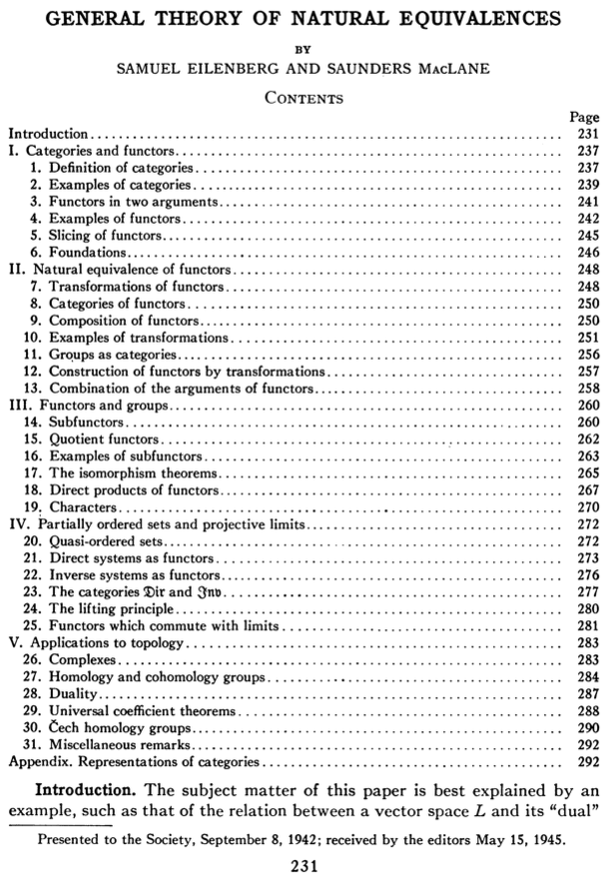
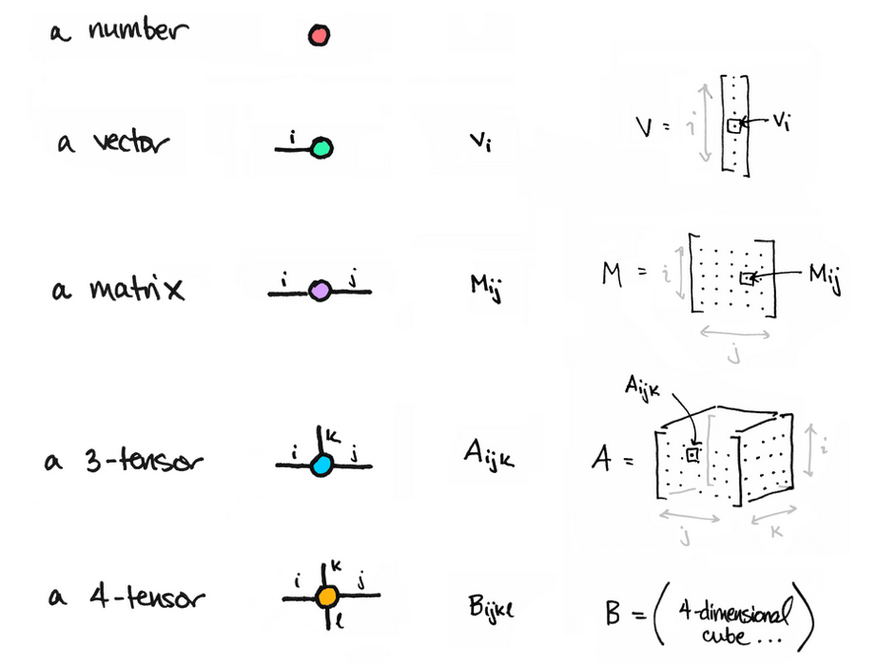
Compositionality and Closure helps formulate different types of Comparison/Equivalence
Image Source: math3ma

Slide 24
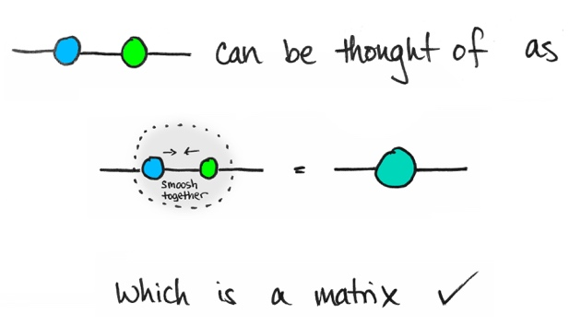
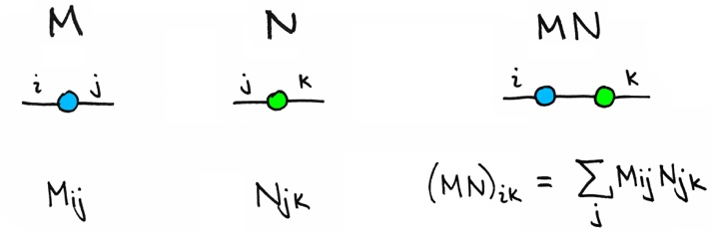



A Topological Way to Compose Matrices
Image Source: math3ma

Slide 25

From Monism, Dualism to Cyber-physical Systems
Image Source: Double-aspect Theory on Wikipedia

Slide 26


Exothermic and Endothermic
Image Source: exo and endothermic processes on Lumen Learning

Slide 27
Market Dynamics
Bearish Market
Bullish Market
Transaction Costs
Transaction Costs
Image Source: exo and endothermic processes on Lumen Learning

Slide 28


Soundness
Completeness
For engineering/scientific purpose, it is difficult to escape Monism
The unifying notion of “Truth” is the source of Monism
Every provable statement is true
Every true statement is provable
Cited from : Soundness and Completeness: With Precision on news.ycombinator.com
https://youtu.be/3hspKYIn5ds?t=29
https://youtu.be/3hspKYIn5ds?t=162

Slide 29





系统设计方法论的充分与必要条件 (Patrick & Radhia Cousot的核心主张)
Soundness
Precision
Termination
（可靠性）
（精确性）
（可终止）
Soundness: All provable truth are true;
Completeness: All truth are provable;
Precise semantics: Avoid False Positive/Negative.
Terminable: The program of interest eventually stops;
Bounded Term.: The said program stops given a bound;
标示语义(命名空间)的精确程度
可根据应用场景的需求，
即时地调用可供决策的
算法与相应的度量衡
系统建模所描述的
“假设”与“断言”
(Assumptions/Assertions)
与运行结果一致
在有限的时间与计算资源内
得到可供决策的系统模型评估结果
Notes:
(notes) add hyperlinks with definitions
Soundness: A Sound statement is a true statement whose composed sub-statements all accountably true, and the overall constructed statement also can be assessed to be true.
The degree of a statement to be sound is its Soundness assessment.
Precision (The result has a outer boundary)
Termination (It will come to completion)

Slide 30





所有的数据类型均为偏序集 （偏序集由有向关系所构成）
万用性/Universality
通过标示/数学语义的研究
（Denotational/Mathematical Semantics）
将计算方法论从
艺术提升到科学层次的鼻祖
lowest upper bound (lub)
并 (Join/Top)
公理1:一个数据类型对应于一个偏序集
Dana Scott: 1976 图灵奖得主
Image Source: Wikipedia
greatest lower bound (glb)
交 (Meet/Bottom)
所有数据类型均为“格”
偏序集： Partially Ordered Sets/Lattice(格)
Lambda Calculus 的 前世今生

Slide 31



现有数据的影响范围可被抽象编码为局部时空区间的“格”
影响空间
未来
物理事件交互影响的效力边界
物理事件交互影响的效力边界
时
间
轴
/
时序命名空间
公共空间
现在
公共空间
物理事件交互影响的效力边界
物理事件交互影响的效力边界
Image Source:
Wikipedia on 光锥/因果锥
过去
影响交互空间
空间轴 /方位命名空间

Slide 32
What is the big deal?
Cybernetics organizes abstractions at different scales:
A formal/mathematically rigorous structure (Poset/Lattice)
Engineered solutions for Human-Machine Interfaces
Many complex ethical concerns becomes everyday decisions
Consensus must be reached a higher frequencies than before
Time and Space encoded with Controlling Mechanisms as the main theme
Automated Verification Tools is now available (K-Framework mentioned later)

Slide 33
Recognizing the Fact
All Knowledge represented by Named Functions
This set of rules can be used recursively to generate an infinite amount of expressions.
Variable
Expression1
Expression2
𝜆
Variable
Expression
( )
Expression

Slide 34
The Universal Structure in 𝜆-Calculus Form
Expression := Contextualized Data (* Known interpretation results, no computation *)
| Goal_Exp Criteria_Exp (* Timeless and Time-based expressions *)
| 𝜆 Input Output_Exp(Input) (* A Computing Process *)
| ( Exception_Handling ) (* Stated boundary conditions/Exceptions *)
This set of rules can be used recursively to generate an infinite amount of expressions.
What
Contextualized data
Goal Expr
Criteria Expr
Why
𝜆
Input
Output Spec
How
( )
Exception Handling

Slide 35

Recursive Structures as a Rewrite System
(Rewrite = Replacement)
Image Source: https://speakerdeck.com/glebec/lambda-calc-talk-frontside-version?slide=66

Slide 36
Monad is an actionable Abstraction
Image Source: https://speakerdeck.com/glebec/lambda-calc-talk-frontside-version?slide=66

Slide 37
Universal set of Replacement Rules
Expression := Variable (* Atomic results, replace nothing *)
| Expression Expression (* Expansive or One-to-Many replacement *)
| 𝜆 Variable Expression (* replace variable content in Expression *)
| ( Expression ) (* Isolate replaceable Expression with boundaries *)
This set of rules can be used recursively to generate an infinite amount of expressions.
Variable
Expression1
Expression2
𝜆
Variable
Expression
( )
Expression

Slide 38
This might look familiar
Expression := Contextualized Data (* Known interpretation results, no computation *)
| Head_Exp Tail_Exp (* Timeless and Time-based expressions *)
| 𝜆 Input Output_Exp(Input) (* A Computing Process *)
| ( Bounded_Exp ) (* Stated boundary conditions/Exceptions *)
This set of rules can be used recursively to generate an infinite amount of expressions.
Contextualized data
Head
Tail
𝜆
Input
Output Spec
( )
Bounded Expression

Slide 39
This meaning of “Equal”
Expression := Contextualized Data (* In a rewrite system, equal or := is a rewrite rule *)
| Head_Exp Tail_Exp (* this is a branching structure *)
| 𝜆 Input Output_Exp(Input) (* A simplification procedure*)
| ( Bounded_Exp ) (* Special case manipulation/Exceptions *)
For single threaded computation, all functions can be derived from here.
For multiple-threaded system, see 𝞹-calculus
Contextualized data
Head
Tail
𝜆
Input
Output Spec
( )
Bounded Expression

Slide 40


For Concurrent Systems (𝞹-calculus)
Image Source: Wikipedia

Slide 41




Well-known Rewrite Systems
Image Source: Mathcing-Logic.org

Slide 42


An Ideal Language Framework Vision
We pursue it with the K framework [www.kframework.org]
Currently, K uses Matching Logic to specify static structures of programs and Reachability Logic to specify dynamic (reachability) properties.
Can we unify Matching Logic and Reachability Logic so that K has a uniform foundation?
Can we have a more powerful logic that goes beyond Reachability Logic (eg, liveness properties as in LTL/CTL)?
Slide created by: Xiaohong Chen and Grigore Rosu
Notes:
Specifically, that programming languages must have formal definitions, and that tools for a given language, such as interpreters, compilers, state-space explorers, model checkers, deductive program verifiers, etc., are derived from just one reference formal definition of the language, at no additional cost specific to that language.

Slide 43

Matching 𝝁-Logic as unifying semantic foundation
Slide created by: Xiaohong Chen and Grigore Rosu

Slide 44


Sound and complete proof system
Sample derivation:
Local reasoning globalized (“structural framing” for free!)
Above derivation can be lifted to whole configuration
[RTA’15]
Slide Source: Grigore Rosu download link

Slide 45

Proof System for Reachability
Proves any reachability property of any lang., including anything that Hoare logic can (proofs of comparable size)
[FM’12]
Sound (partially correct) and relatively complete
[ICALP’12], [OOPSLA’12],
[LICS’13], [RTA’14]
Slide Source: Grigore Rosu download link

Slide 46
Controlling Types
A unique feature of Category Theory, is that it provides a meta-mathematical framework to introspect itself. This can be found in the way lambda calculus and the three types of functions, namely
Morphisms (Head label representing its tail or content)
Functors (An indirection that allows some intermediate replacement action)
Natural Transformations, (A kind of function that points to itself)
are defined. This mathematical framework uses only three types of functions (functions being the root type), to represent everything.
This flattened type examination mechanism, instill a universal discipline to check and verify soundness and completeness of all variations of structures, as well as values in any namespace, so that it provides the most succinct, yet overarching abstraction of all.
More importantly, this universal mechanism has been operationalized by computing machinery to offer both automation as well as scalable reasoning of type, so that it is becoming a foundational layer of our modern civilization. The incorrect or biased implementation of this mechanism, is the source of inequality in our society.

Slide 47
Relevance to Cybernetics
The control and communication of systems requires not just raw content, but a structure to manage the interpretation of implicit relationship between entities in a system. This has been a major hurdle that hasn’t be addressed in most other types of mathematical framework, until Category Theory.
Now, the type-based interpretation framework can be found in many fields of mathematics, partially due to the revelation in Logic, Lambda Calculus, and Category Theory. That all these implicit structures are isomorphically mapped to each other, also known as the “Curry—Howard-Lambeck Correspondence”.
It is because of this correspondence, and the universality of this correspondence, that makes people start thinking that all sciences and mathematical principles can only be discovered, not invented, because they must have already been there before one’s invention.
This is relevant to cybernetics, because in the field of control and communication, many ideas and techniques must have already been found and developed in math, and computing science, therefore, the techniques and knowledge in Cybernetics, must be re-discovering rules and properties that is already in Category Theory and other topological structures in nature.

Slide 48

A philosophical way to interpret Self-Reference
“The self is not something ready-made, but something in continuous formation through choice of action.”
- John Dewey
On page 408 of the Philosophy of Education

Slide 49

Cybernetics: The human use of human beings
The thesis of the book is that:
society can only be understood through a study of the messages and the communication facilities which belong to it; and that in the future development of these messages and communication facilities, messages between man and machines, between machines and man, and between machine and machine, are destined to play an ever-increasing part. (p. 16)
- Wikipedia on Human use of Human Beings
“Some agents can transcend one system and reset its goals from a vantage-point of a meta-system (Hofstadter, 1979). While many animals are capable of a wide repertoire of diverse goal-seeking activity, human minds appear to be (for now) in a unique position. .”
- Michael Levin in the computational boundary of “self”

Slide 50

Cybernetics: Entropy and Negative Entropy
Wiener believed that communication of information is essentially negentropic – it resists entropy –, because it relies on organizational structures. There are two kinds of possible disorganizational forces, passive and active:
"Nature offers resistance to decoding, but it does not show ingenuity in finding new and undecipherable methods for jamming our communication with the outer world" (pp. 35–36).
- Wikipedia on Human use of Human Beings
Willard Gibbs’ 1873 available energy (free energy) graph, which shows a plane perpendicular to the axis of v (volume) and passing through point A, which represents the initial state of the body. MN is the section of the surface of dissipated energy. Qε and Qη are sections of the planes η = 0 and ε = 0, and therefore parallel to the axes of ε (internal energy) and η (entropy) respectively. AD and AE are the energy and entropy of the body in its initial state, AB and AC its available energy (Gibbs energy) and its capacity for entropy (the amount by which the entropy of the body can be increased without changing the energy of the body or increasing its volume) respectively.
- Wikipedia on Negentropy

Slide 51



Entropic namespaces in Partially Ordered Sets
Image Source: Symmetric chain decompositions of partially ordered sets by Ondrej Zjevik

Slide 52


Stages of Control in Cybernetics
Figure 1 of The Computational Boundary of a “Self”

Slide 53

Controlled Boundaries (Poset) of different Scales
Figure 2 of The Computational Boundary of a “Self”

Slide 54


Controlled Boundaries of different Scales
Figure 3 and 4 of The Computational Boundary of a “Self”

Slide 55

Agent actions in the world of Posets
On P.4 of Embedded Agency by Abram Demski, Scott Garrabrant

Slide 56

A cool video on Functors
https://youtu.be/DisD9ftUyCk?t=240

Slide 57

A cool video on Monad
https://youtu.be/9QveBbn7t_c

Slide 58



Monad and Leibniz
The Monad, of which we shall here speak, is nothing but a simple substance, which enters into compounds. By ‘simple’ is meant ‘without parts’. (Theod. 10.)
And there must be simple substances, since there are compounds; for a compound is nothing but a collection or aggregatum of simple things.
Now where there are no parts, there can be neither extension nor form [figure] nor divisibility. These Monads are the real atoms of nature and, in a word, the elements of things.
…. From home.datacomm.ch/kerguelen/monadology/monadology.html

Slide 59


Hamiltonian Mechanics make energy Accountable
Assets = Liability + Equity
and
H = T + V
These two equations basically dominated two fields: Economics and Physical Sciences
Thinking from a Meta-Mathematical viewpoint,
they present a way to break down the total amount of conservative resources,
and therefore, allows iterative branching and therefore continuous replication.
Notes:
“historian James Aho linked double-entry bookkeeping to the ancient art of rhetoric,”
Excerpt From: Jane Gleeson-White. “Double Entry.” Apple Books.

Slide 60



Hamilton did more work on the Accounting Equation
The aim of this paper is to show how the mathematical basis is used for a precise treatment of double-entry bookkeeping, which was firstly developed in the nineteenth century by Sir William Rowan Hamilton. This is done by using basic notions of matrix algebra with the roots to the idea of using ordered pairs. We also reveal how the complex numbers and the rationals (fractions) developed in a mainstream of accounting science and became a leading platform for the ongoing processes within the Industry 4.0.
Image Source: Research Gate
Notes:
In the presentation on Oct-9, 2020, Ray again, stated a link between the Atomic Explosion’s 20 thousands generations of chain reactions and the layers of Syntatic Trees in Chomsky’s Syntactic Theory about language. Then, he also reminded us that Chomsky and Shannon were working in locations that are 100 feet away from each other. The white and black dots are demonstrating the patterns of Fibonacci series.

Slide 61

The second Language Design Strategy
combine structure with operations!
The isomorphism between accounting equation and the Hamiltonian formulation states: Science is about utilizing symmetries/invariance recursively.
Put the Accounting /Hamiltonian equation in a matrix structure, the addition operations becomes iterative.

Slide 62


Kuhn Cycle: recursion and symmetry-breaking
Keeping namespace consistent (is challenging)
Normal Science
Model
Drift
Model Crisis
Model Revolution
Paradigm
Change
Emerging cases or
systematic attacks
Ouroboros Snake
in five named stages

Slide 63

Concrete Activities in Daily Workflow
What is DevSecOps?
Image courtesy: Paladion Corporation Website Image source: https://www.paladion.net

Slide 64





Connecting Abstract and Concrete Domains
4th POPL, pages 238-252, Los Angeles, CA, 1977. ACM Press.
Prof. Cousot and Koo in 2005
Course number: 16.399 Title: Abstract Interpretation Units: H level course, 3-0-9 Lecture hours: Tuesday 11:00–12:30 and Thursday 11:00–12:30 (see the course schedule for exceptions) Location: 33–419 Course web site: http://web.mit.edu/afs/athena.mit.edu/course/16/16.399/www Prerequisites: basic skill in mathematics and experience with computer programming.
Conclusion (the second paragraph)
There is a fundamental unity between all these apparently unrelated program analysis techniques : a new interpretation is given to the program text which allows to build an often implicit system of equations. The problem is either to verify that a solution provided by the user is correct, or to discover or approximate such as solution.
http://web.mit.edu/afs/athena.mit.edu/course/16/16.399/www/

Slide 65


打破认知边界的传奇符咒
系统的两类合约：
安全与活性
Safety: （安全）
Something bad never happens
Liveness: （活性）
Something good eventually happen
The Byzantine Generals Problem * 388
找到了计算信息传递可信度的数学理论
拜占庭将军的问题：提出了分布式数据库的可信度检验算法
http://slideplayer.com/slide/4339032/
ACM Transactions on Programming Languages and Systems, Vol. 4, No. 3, July 1982.

Slide 66
Think about all activities as Posets/Lattices software projects in version control database
Normal Science
(commit)
Model
Drift
(build)
Model Crisis
(test)
Model Revolution
(stage)
Paradigm Change
(deploy)
Time Stamp
Time Stamp
Time Stamp
Time Stamp

Slide 67

Paxos as a Poset

Slide 68





Holacracy: a mechanism for Communication and Control
Holacracy applied Recursively
Image Source: Holacracy: The New Management System for a Rapidly Changing World

Slide 69
Abstraction
Concretization
Safety
Nothing
bad happens
Liveness
Some
Good Things
Must Happen
A well-defined set of Actions and iterative Branching Strategies
A Roadmap of composable activities
Sequencing and timing conditions
Explicitly state dependencies and resource requirements
Correctness

Slide 70
Iteratively Fixing Security Problems
Technology Integration
Technology
Society
Security
Technology
Security
Society
Technology Isolation
Modified from Figure 1-1 and 1-2 of Agile Application Security: Enabling Security in a Continuous Deliver Pipeline,
by Laura Bell, Michael Brunton-Spall, Rich Smith & Jim Bird, O’Reilly Media, 2017

Slide 71



The Version Control, Built, Test, Stage, Deploy are Conducted by Human Instructions
Think of a multi-staged snake…
Image courtesy: Learn How to Set Up a CI/CD Pipeline From Scratch on DevOps Zone

Slide 72
A compositional view of system correctness
Liveness
Safety
Correctness
The Theoretical Definition of System Correctness
Correctness = Liveness ∧ Safety
Liveness: Something good eventually happens
Safety: Nothing bad ever happens

Slide 73

辩证系统正确性的形式化表述
Abstract Specification
抽象规格
lowest upper bound (lub)
并(Join)
可能空间
系统正确性的逻辑断言(assertion)表达式
Correctness Assertion = Safety ^ Liveness
领域专用语言
(Domain Spec Lang):
以不容混淆的
命名空间(Namespace)
来标示系统运行时的
时空交互现象与关系
安全
Safety
（避免坏事发生）
活性
Liveness
（保证好事发生）
安全
活性
正
确
正确
确认
安全性与活性
交(Meet)
greatest lower bound (glb)
Boundary Conditions
边界条件
以上的Venn Diagram, 表达了
安全与活性系统规格空间的交集与联集关系。
交集与联集关系可用偏续集表达。

Slide 74



系统建模是一个模型空间搜寻过程 （fixed point semantic formalize model interpolation）
函子：比较系统内在结构的映射机制。
Abstract Interpretation With Professor Patrick Cousot
| Lecture Series on AI #11 | J.P. Morgan
𝛾：映射到具象系统的函子
正确的
具体现象
正确的
抽象规则
安全
活性
安全
活性
抽象解释所用的
伽罗华连接算式
𝛼：映射到抽象系统的函子
具象系统
Concrete System
抽象模型
Abstract Model
Image source: A Galois Connection Calculus for Abstract Interpretation by Patrick Cousot

Slide 75












在跨领域的决策方案筛选可通过偏序集计算得到结果
专业领域
领域专用语义
数据渲染形式
偏序结构
$$∅$$
偏序关系：高概率 ⋀ 低载重量
Best
EO+LOR
EO+LO
系统决策
EOR+LOR
EOR
EOR+LO
LOR
Direct
LO
EO
可行性枚举语义
$$Best$$
$$∅$$
偏序关系：阶段性任务的执行顺序
路径优化
可达路径语义
偏序关系：财务支出 ⋀ 项目截止日期
1970年前，
在可支配预算资源内，至少完成一次载人月球旅程
财务会计
T< 1970
实际开销<预算
成功登月
数值区间语义
系统正确性

Slide 76

The Commit-Built-Test-Stage-Deploy are Fully Automated
Image courtesy: Learn How to Set Up a CI/CD Pipeline From Scratch from DevOps Zone

Slide 77



NsM with DevOps and CI/CD
https://youtu.be/p7-U1_E_j3w
https://youtu.be/p7-U1_E_j3w

Slide 78
Continuously Adjust the Correctness Area
Liveness
Safety
Correctness
The Inremental Change Approach promoted by DevOps/CICD practitioners

Slide 79


The CAP Theorem in NsM
RICH 70 Tsinghua SEA Cloud Forum, Sep 14, 2020
H. E. Bambang Brodjonegoro,
Minister of Research & Technology, Indonesia

Slide 80


Cybernetics at a Scale of Internet Economy

Slide 81
Summary
Cybernetics is developed as a Trans-Disciplinary Cognitive Foundation
It has a consistent set of name space, and computable/composable language,
The namespace of Cybernetics is highly congruent with Category Theory
It started with medicinal, biological, engineering, and social applications
It explicitly discusses the notion of lattices(Posets), adjoint structures (feedback), languages, …
The ideas and methods have been implemented into our current infrastructures
Kubernetes, Dockerized Container Technologies being used for all of the services that runs this Internet-bound society

